Slide 1
For Good Measure
The Role of Regulatory Records in Environmental Maintenance
Eira Tansey, University of Cincinnati @eiratansey
Hillel Arnold, Rockefeller Archive Center @helrond

Slide 2
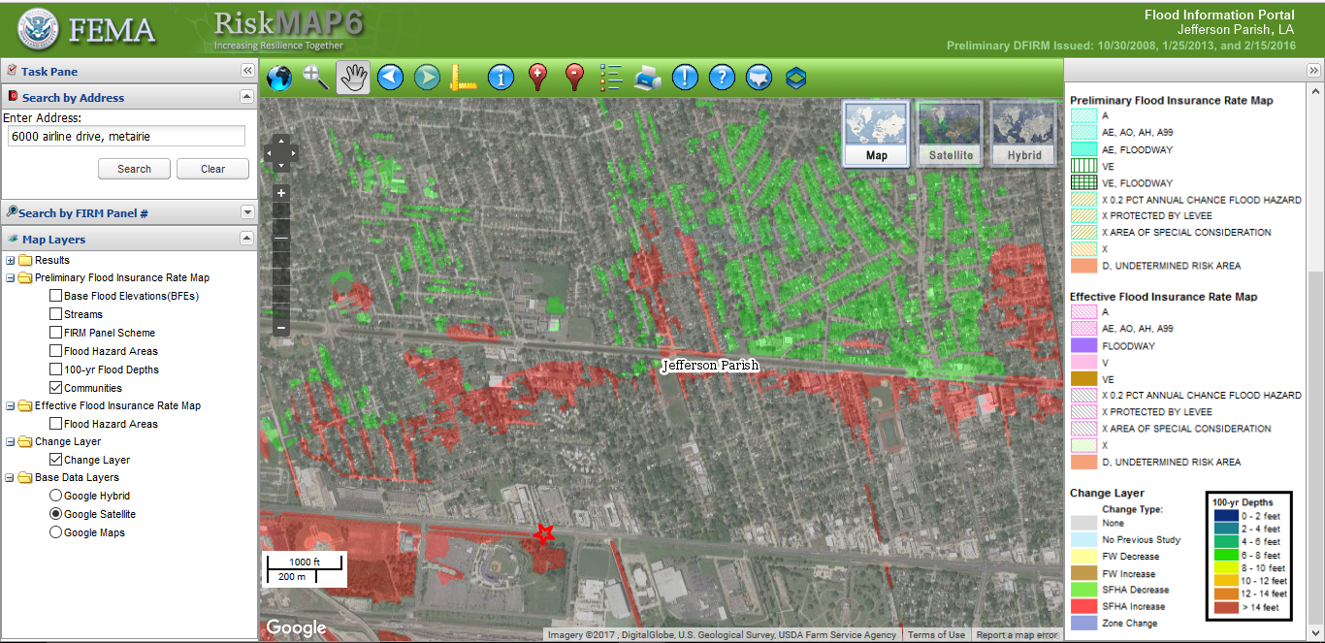
Jefferson Parish (Louisiana) Proposed Flood Insurance Rate Map changes
http://maps.riskmap6.com/LA/Jefferson/

Slide 3
Maintenance is Labor
Invisible
Continuous
Measures change over time
Connected to repair
Ignored or deferred at peril

Slide 4
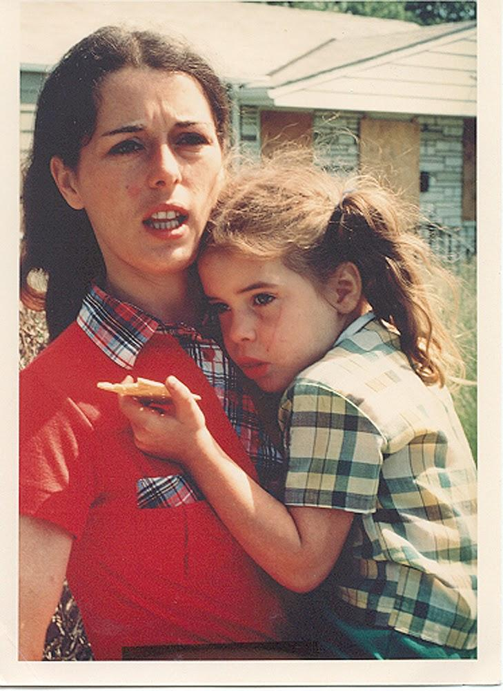
Maintenance is Care
Love Canal activist Lois Gibbs with her daughter, 1979.
frackfreemahoning.blogspot.com

Slide 5
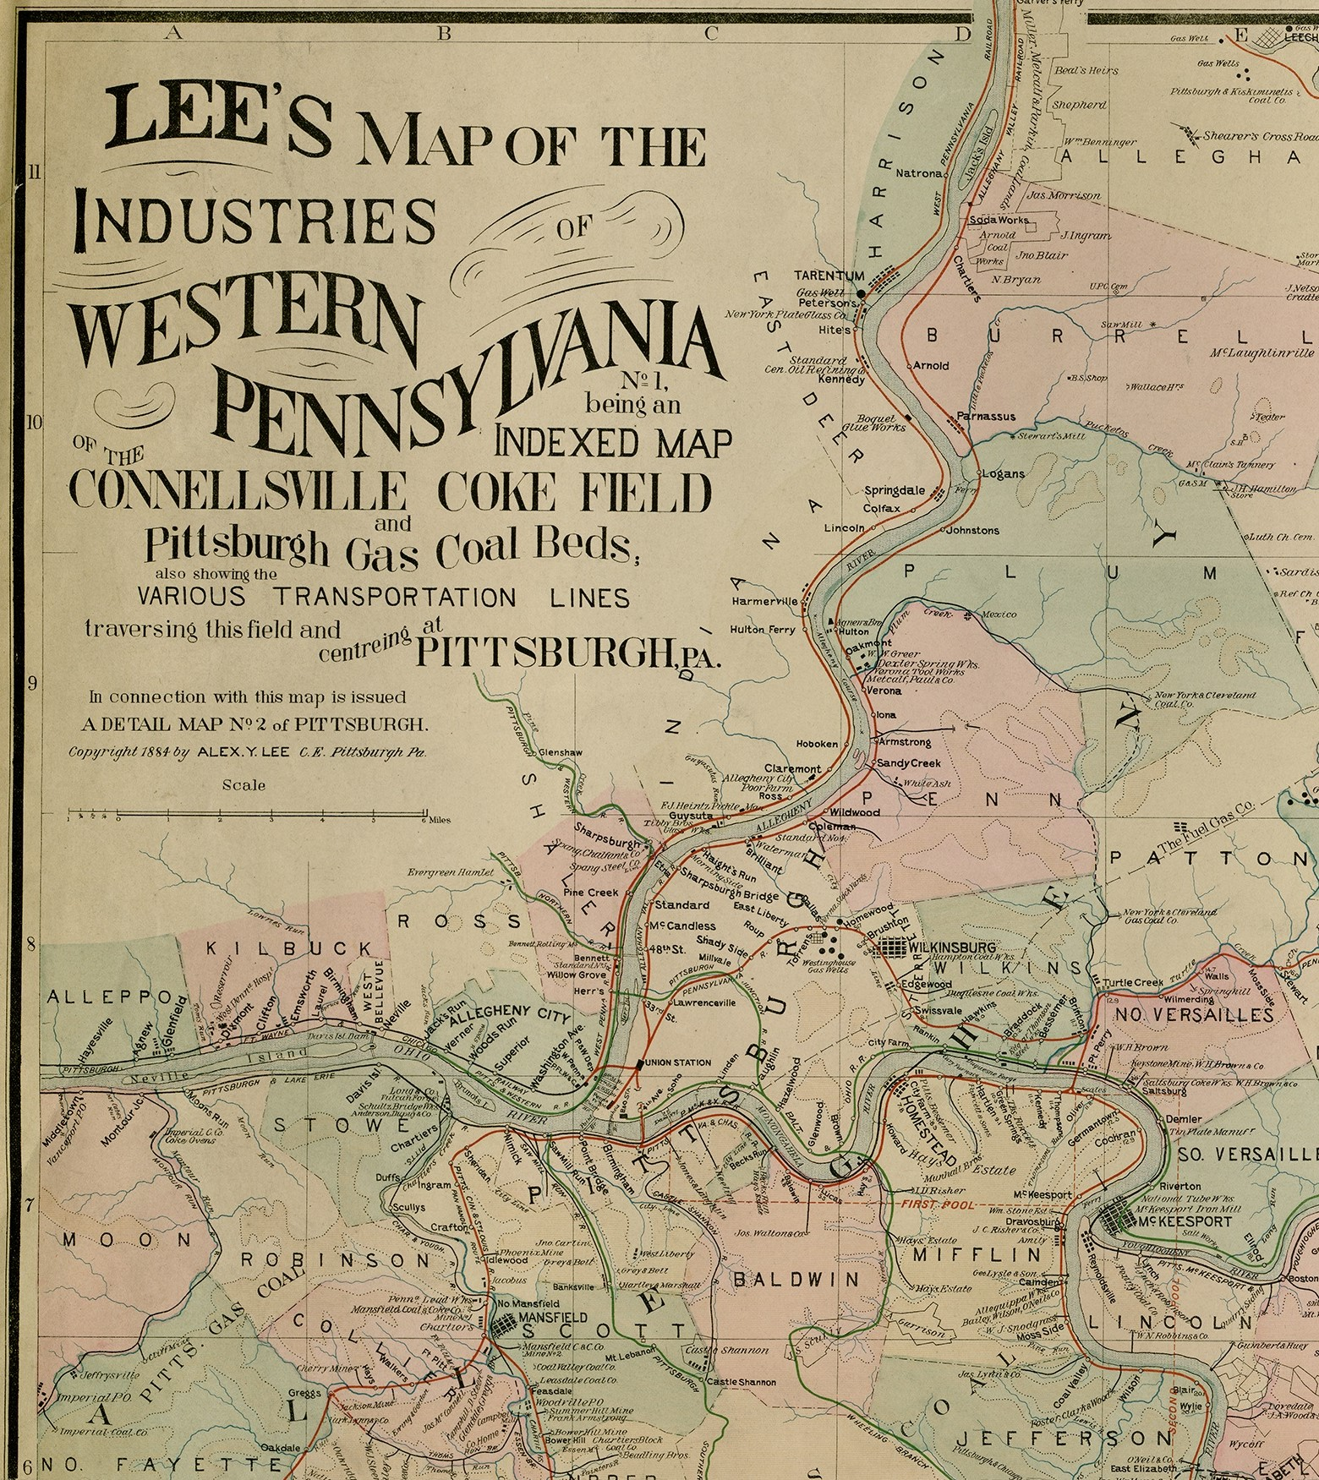
Commodification
before
widespread regulation
Coal beds and coke fields map of Pennsylvania, 1884.
Darlington Digital Library, Archives & Special Collections, University of Pittsburgh Library System

Slide 6
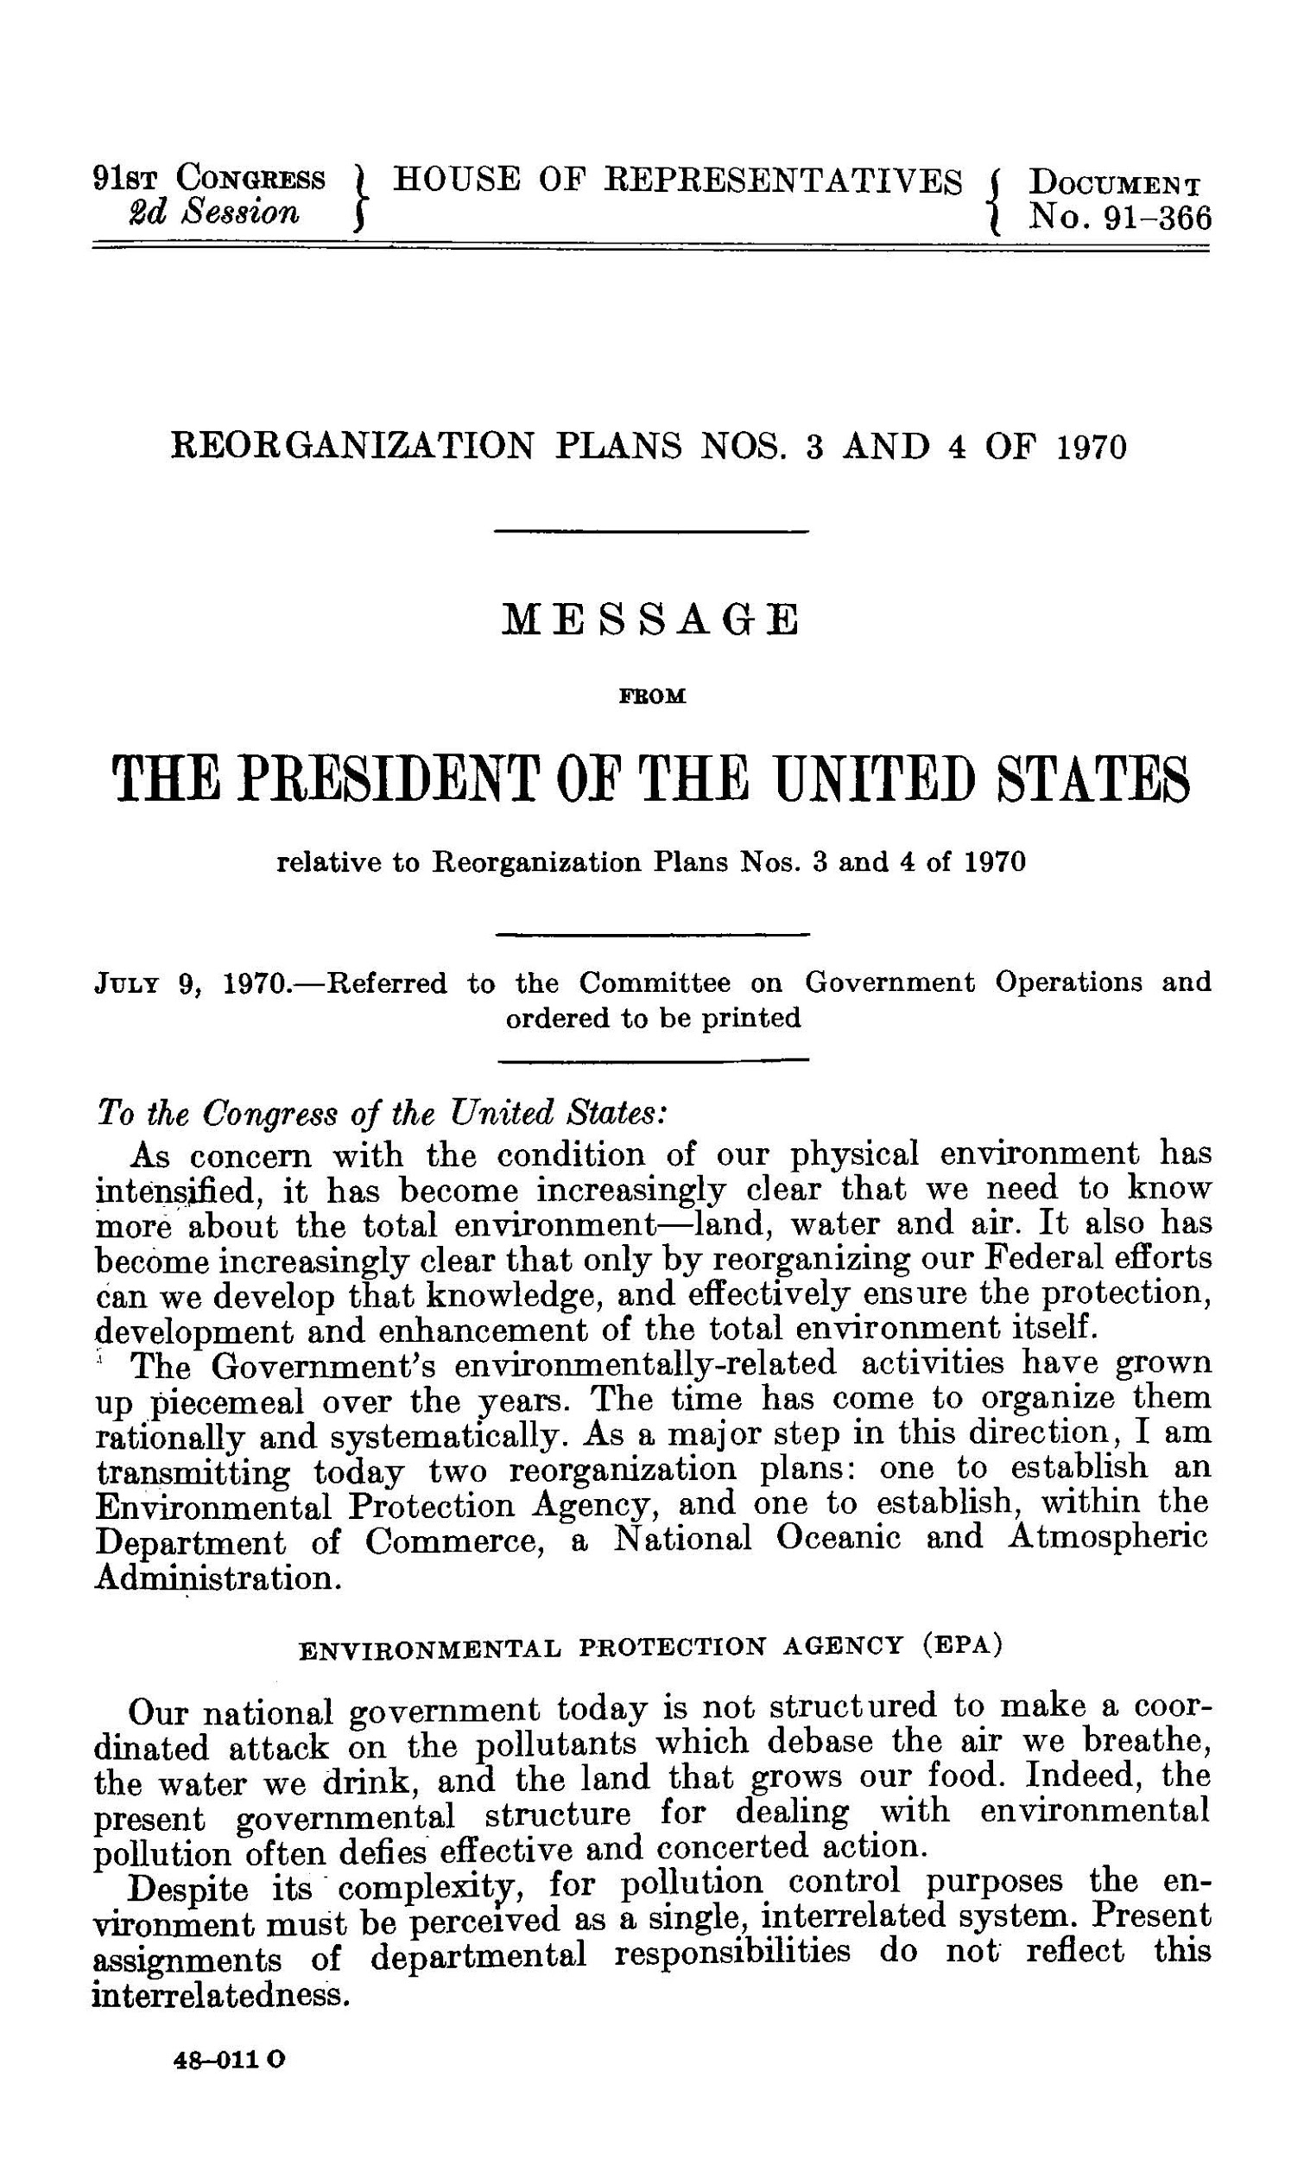
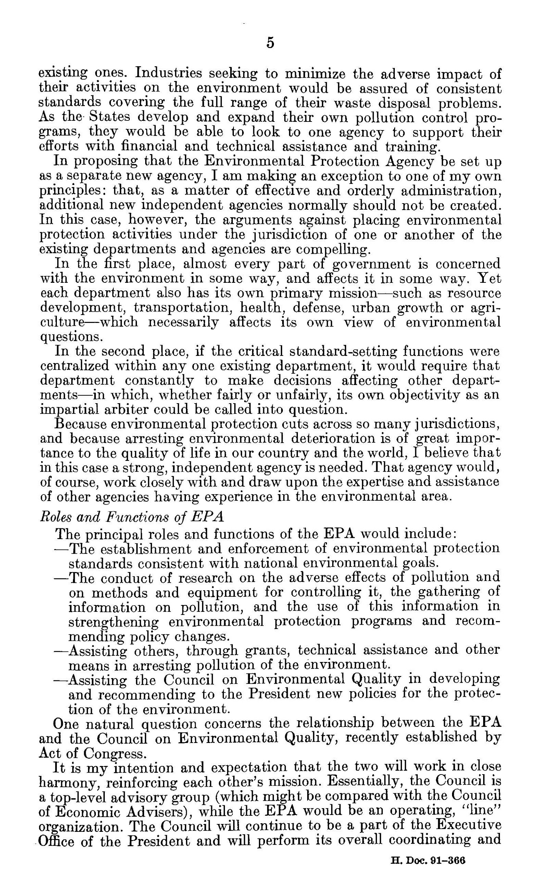
When the EPA was organized, information gathering to inform policy making was part of its primary charge

Slide 7
Recordkeeping is the production and maintenance of records over time.

Slide 8
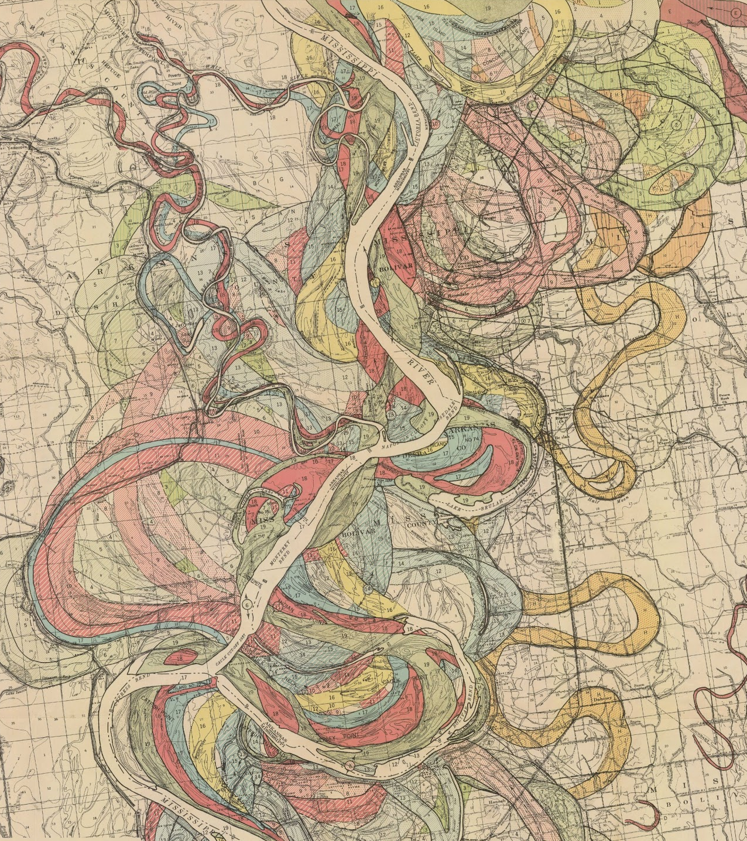
Geological Investigation, Mississippi River Alluvial Valley.
Harold Fisk, 1944.
radicalcartography.net
lmvmapping.erdc.usace.army.mil

Slide 9
EPA Rulemaking Process
Proposed rule
Public comment period
Final rule issued
A proposed rule is published in the Federal Register, supported by an open docket
Public comments on the proposed rule are solicited, usually for a period of 30 days.
After the public comment period has closed, the EPA issues a final rule.

Slide 10
EPA Rulemaking Process - Records
Proposed rule
Public comment period
Final rule issued
Proposed rule
Open docket
Public comments
Revisions to rule
Revisions to rule
Responses to major criticism

Slide 11
Recordkeeping is Maintenance
Invisible
Continuous
Measuring change over time
Ignored or deferred at peril

Slide 12
Recordkeeping is not neutral

Slide 13
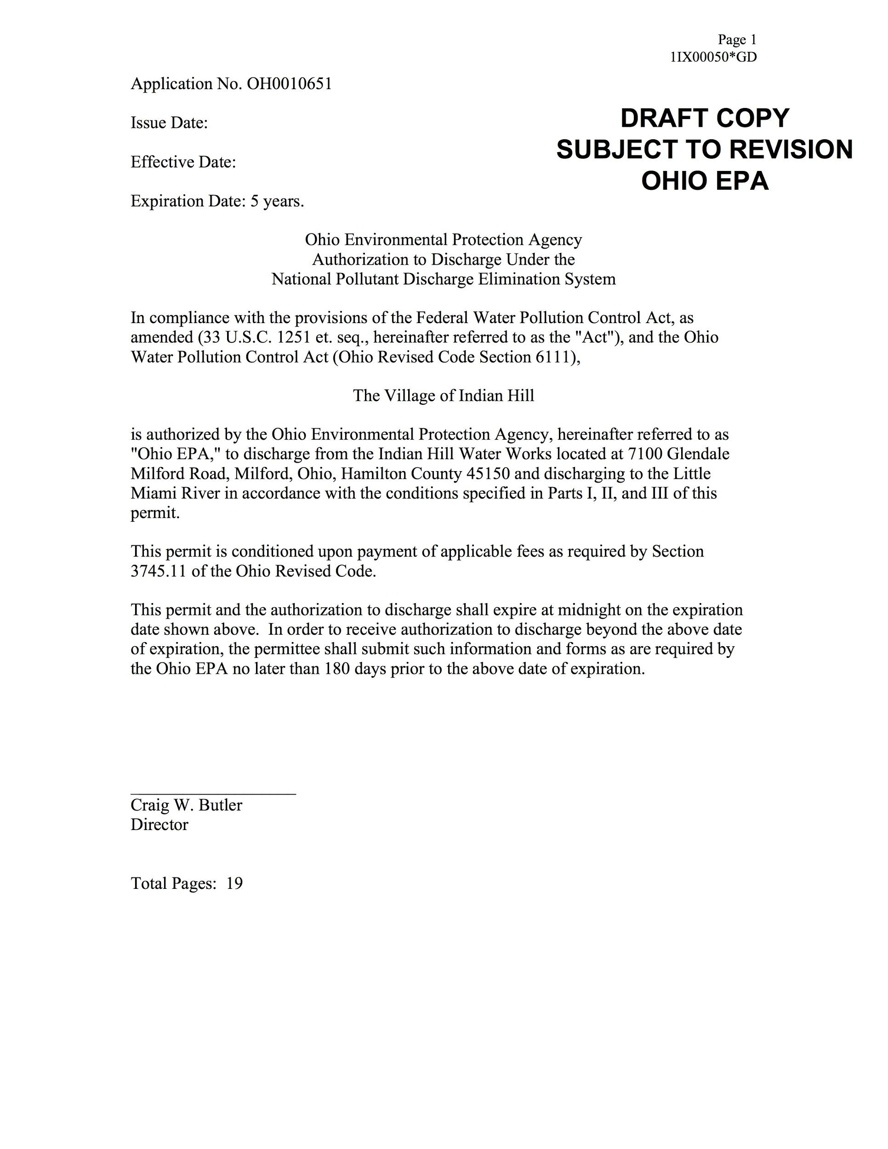
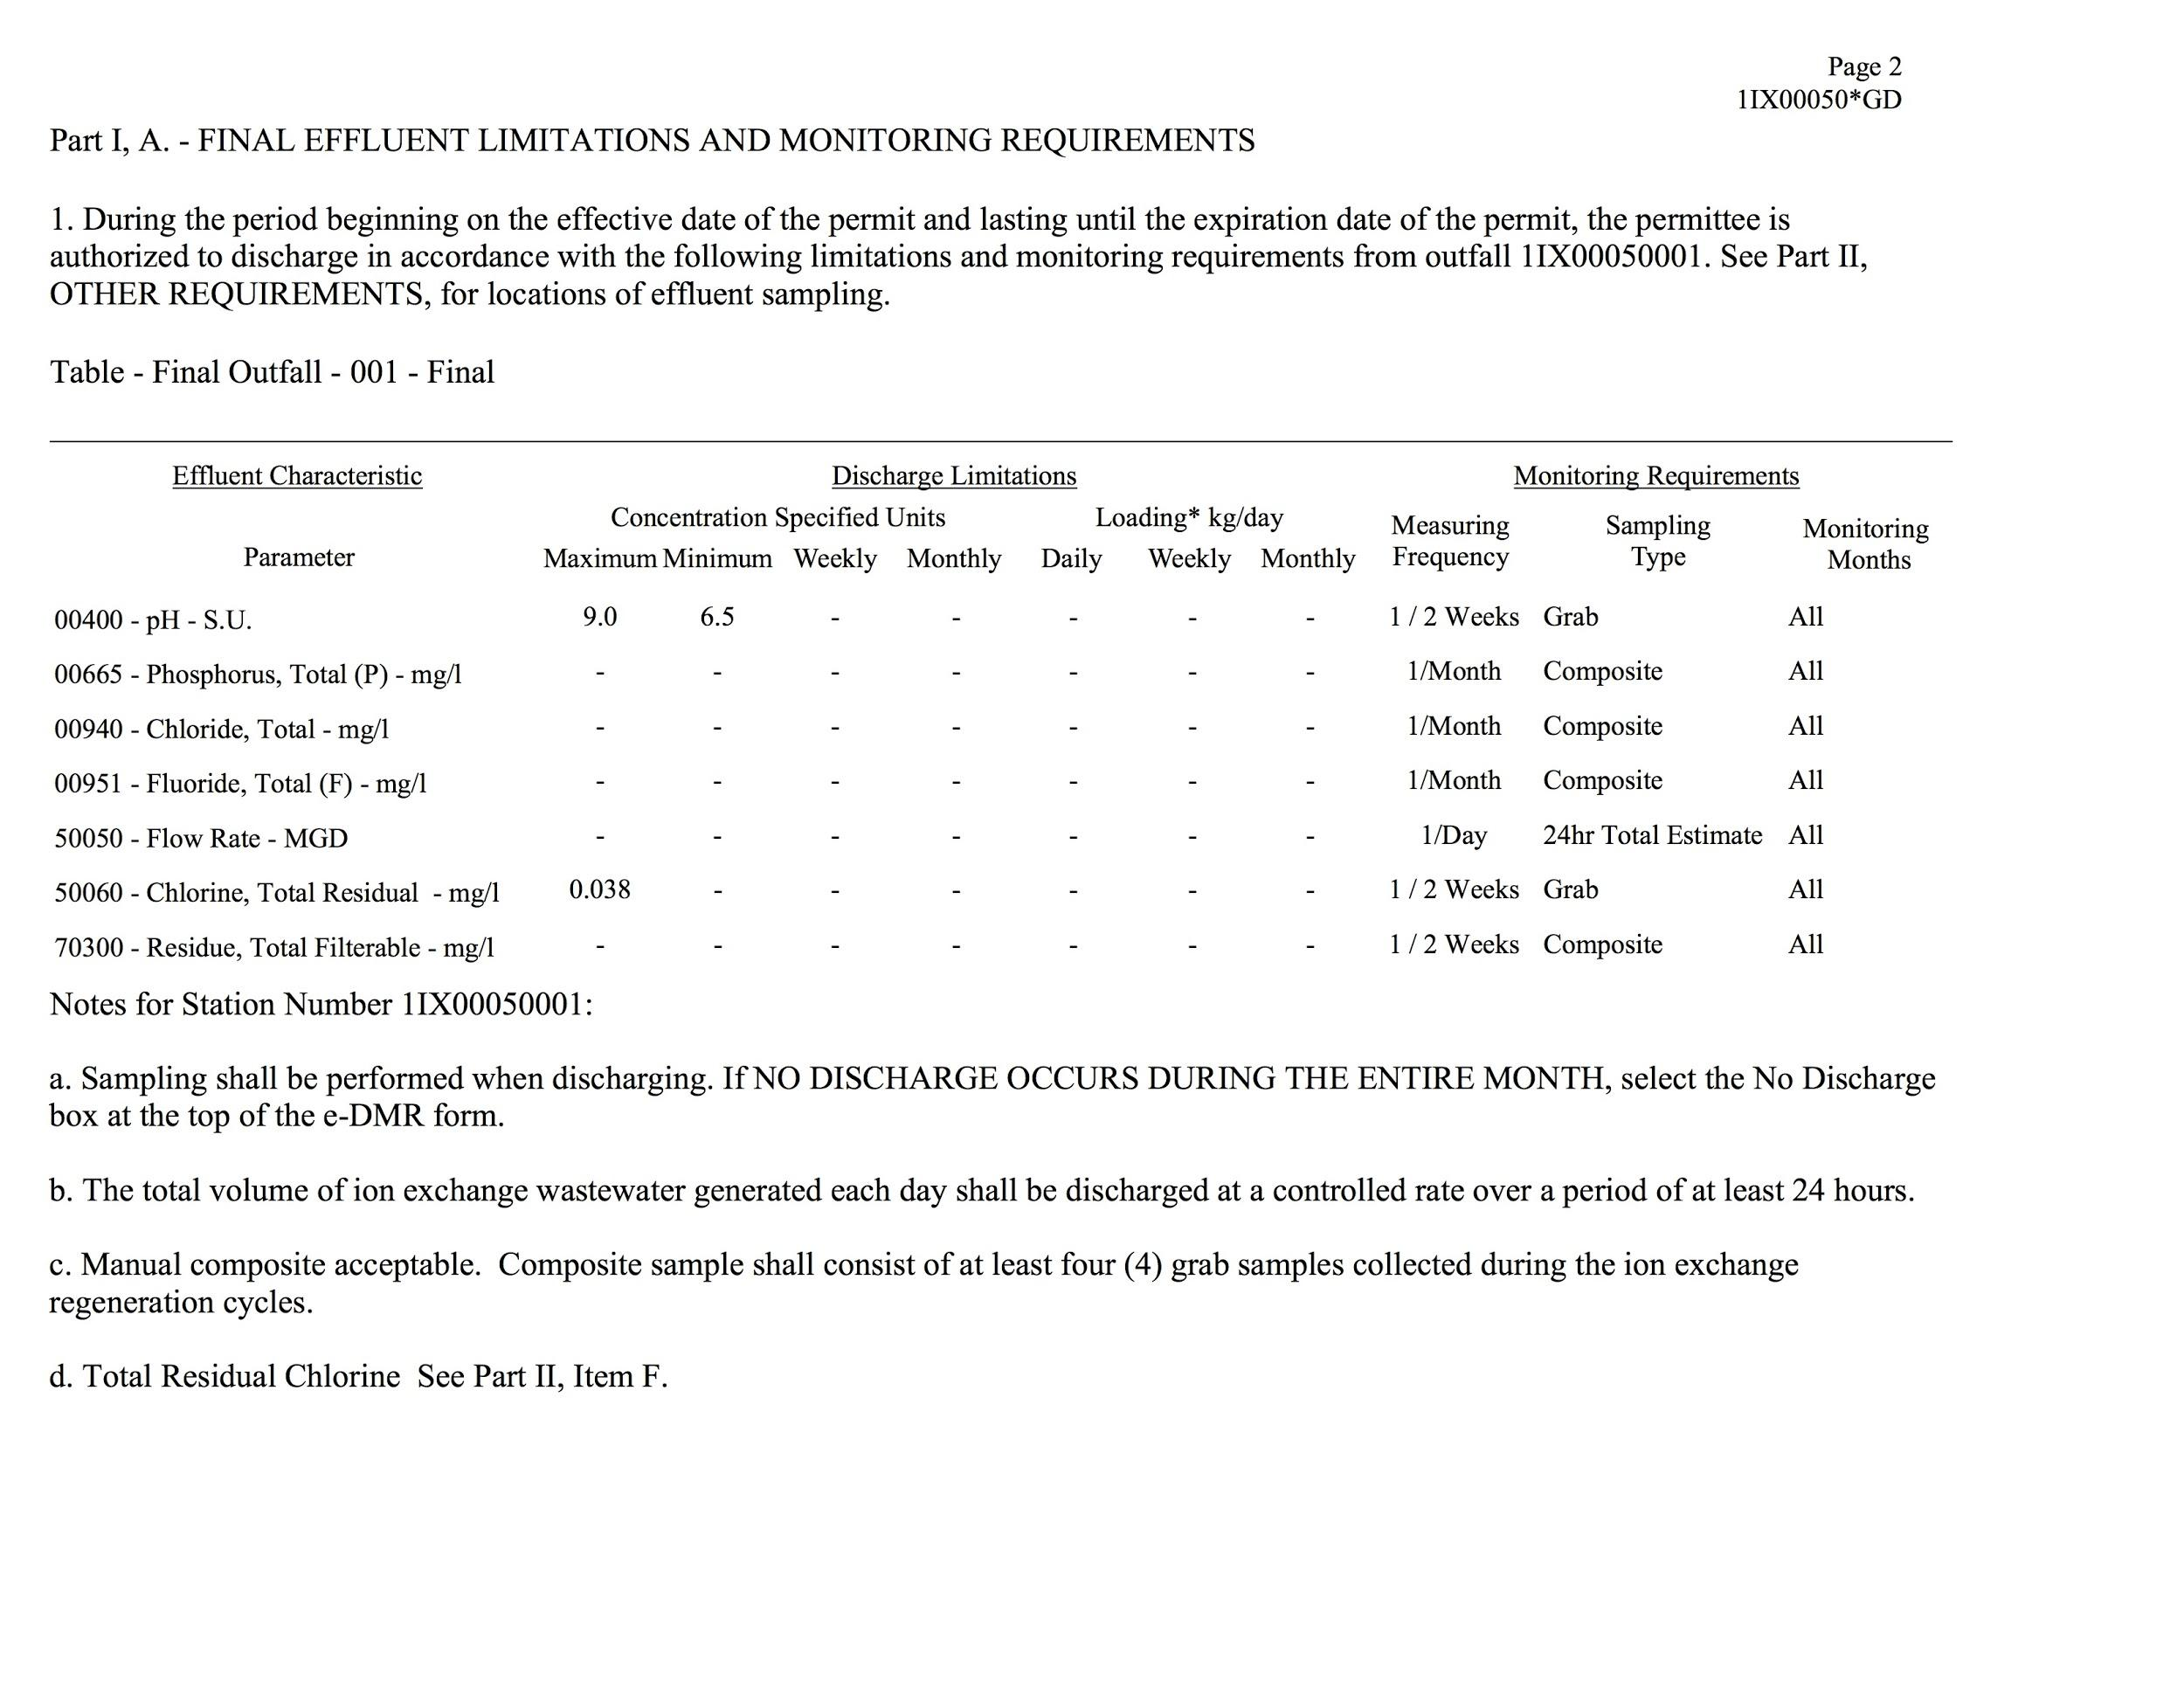

Slide 14
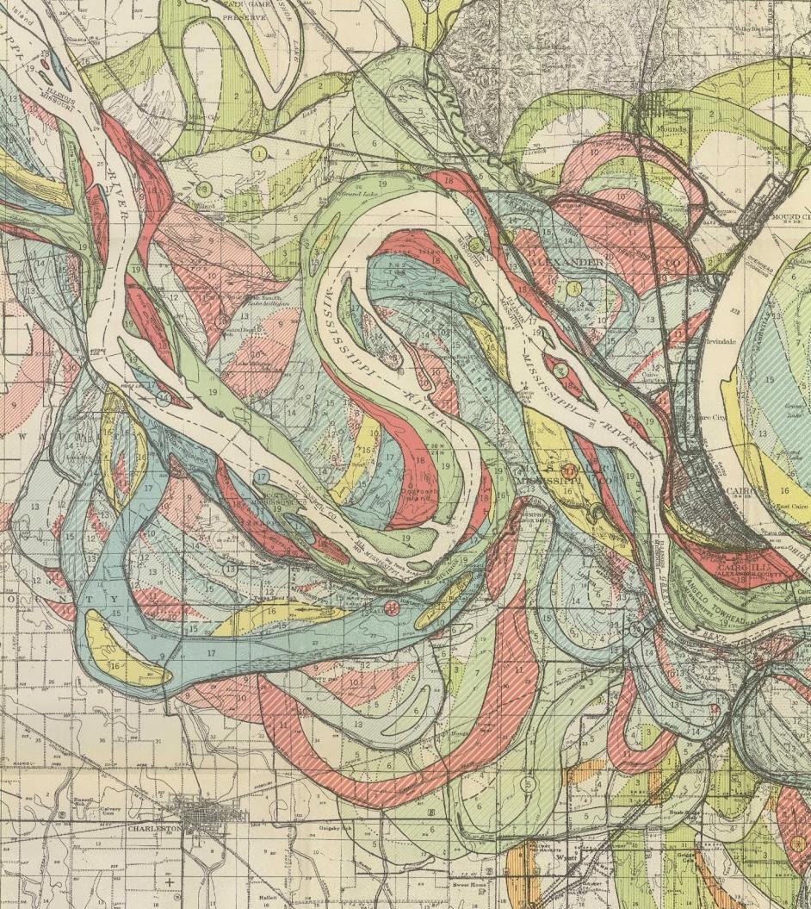
Geological Investigation, Mississippi River Alluvial Valley.
Harold Fisk, 1944.
radicalcartography.net
lmvmapping.erdc.usace.army.mil

Slide 15
Speculative Maintenance
Holistic infrastructure to support care, judgement, and immediate adjustment
Anticipates change
Protects the most vulnerable first

Slide 16
Speculative Recordkeeping
Accessible information
Transparent rulemaking processes
Records of both human and natural activity
Compensation for labor and expertise

